Slide 1
FIT Freak
BY:-ANKUR YADAV
ARCHIT CHITRANSH

Slide 2
OVERVIEW
A fitness app is an application that can be downloaded on any mobile device and used anywhere to get fit.
One of the most important benefits of using a fitness app is 'motivation'. Notification and reminders from fitness apps keep reminding you about your health goals, thus keeping you motivated.
Fitness apps have made our lives easier and enable you to track your activities on a daily basis.
Thus, making you stay focused on your activities and overall fitness.

Slide 3
SCOPE
The future work of this application is to raise your awareness, as a fitness professional in his personal Life, as to how people may select fitness exercise from the many activity that are out there.
If we know what people are looking for from a fitness app then we know what we are competing with from a gym or online trainers point of view.
In Future we will Import:-
Progress Bar – which will show the progress of user.
Navigation Drawer – for better performance.
New Stages – new exercise stages will be added.
Calendar – which will show on which date the exercise is done by the user.

Slide 4
REQUIREMENTS
Functional requirements
Hardware Requirement
Requirements
Non-Functional Requirement
Software Requirement

Slide 5
HARDWARE REQUIREMENTS
Name of component | Specification
Processor | Oreo, Snapdragon 400, MediaTek P20 and above
RAM | 1GB or more
Storage | 2GB or more
Display | Touch Screen

Slide 6
SOFTWARE REQUIREMENTS
Name Of Component | Specification
Operating System | Andriod Version 8.0 and above
Language | Java

Slide 7
SCREENSHOTS

Slide 8
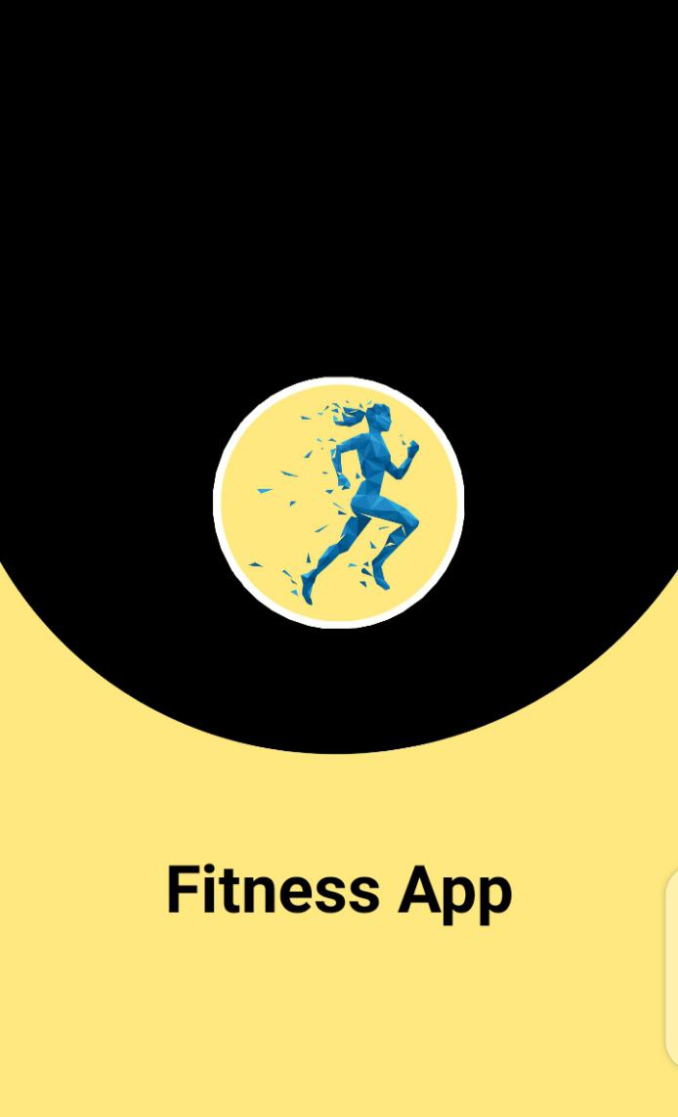
Opening Page

Slide 9
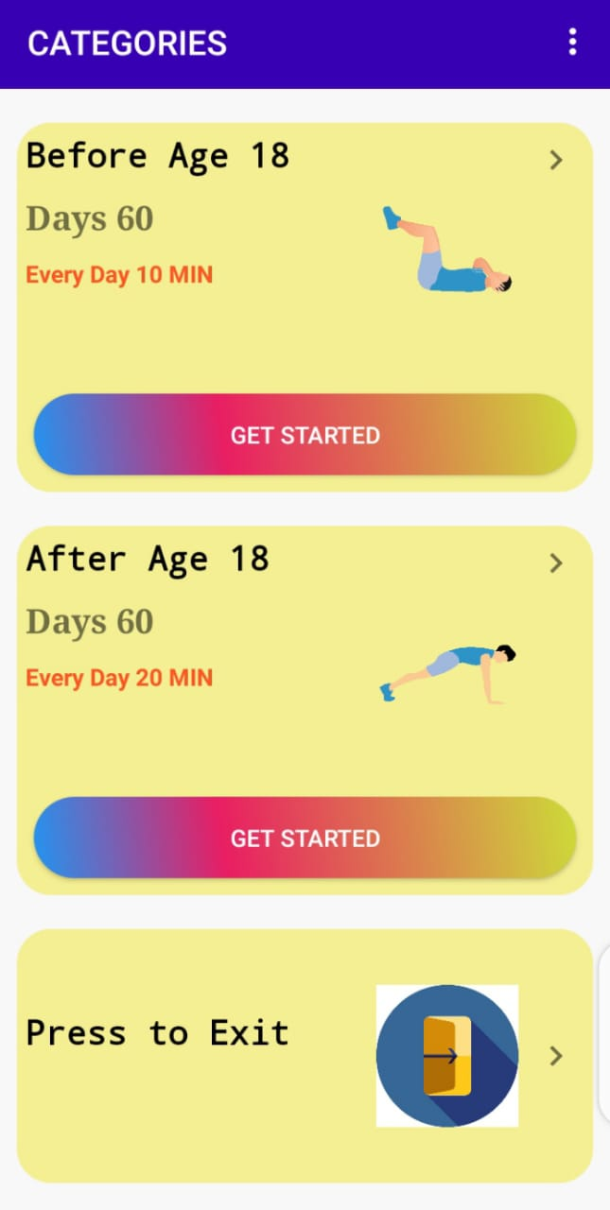
Home Page

Slide 10
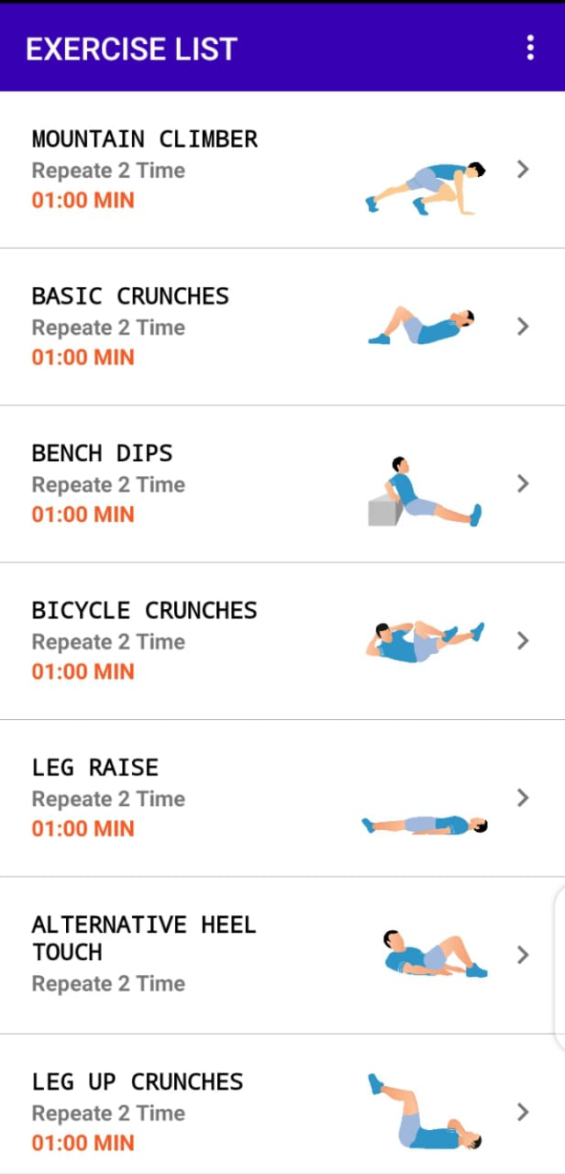
Exercise List

Slide 11
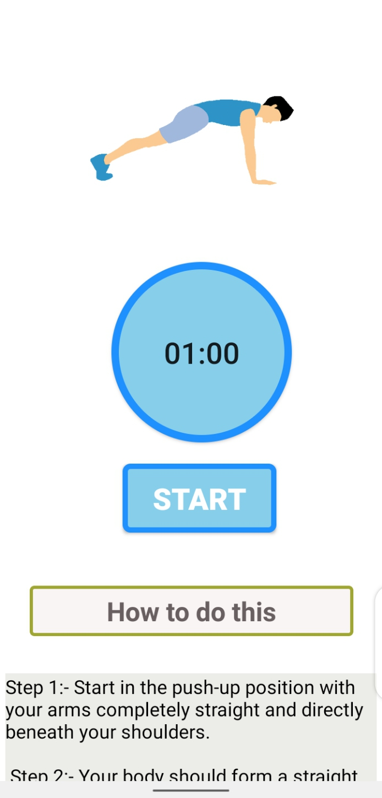
Exercise with Stopwatch

Slide 12
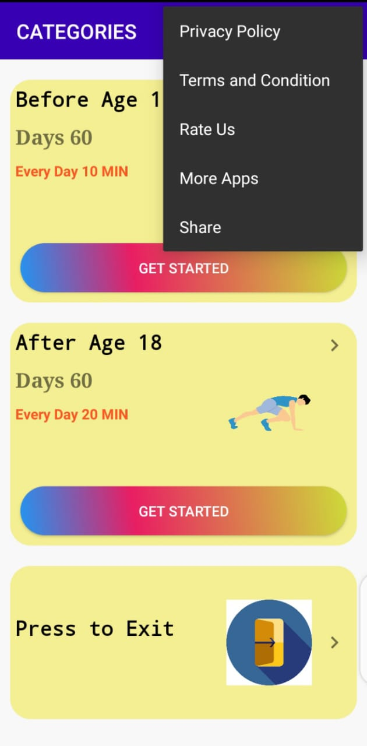
Other Option

Slide 13
DATA FLOW DIAGRAM (DFD)

Slide 14
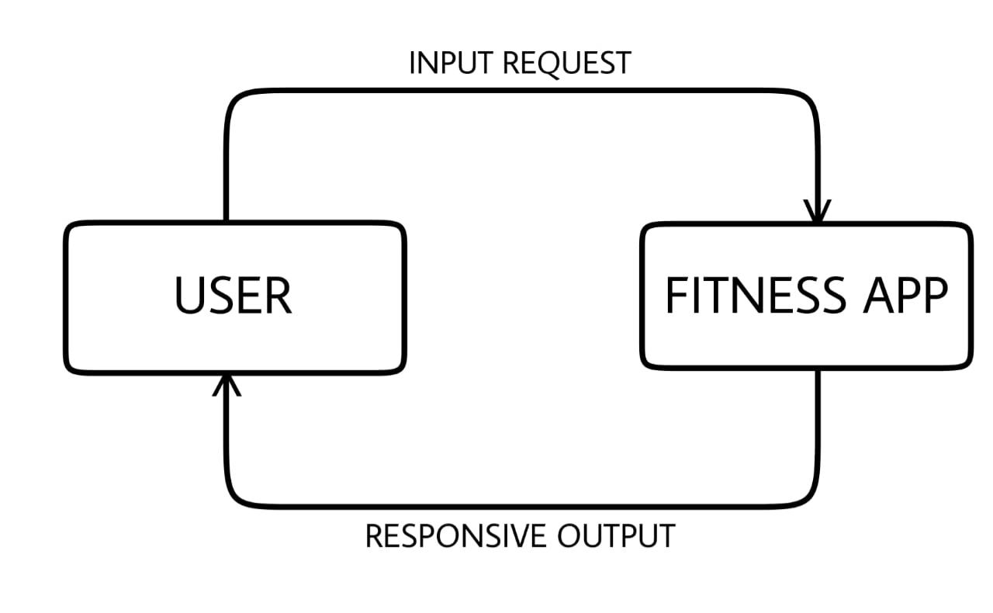
DFD LEVEL 0

Slide 15
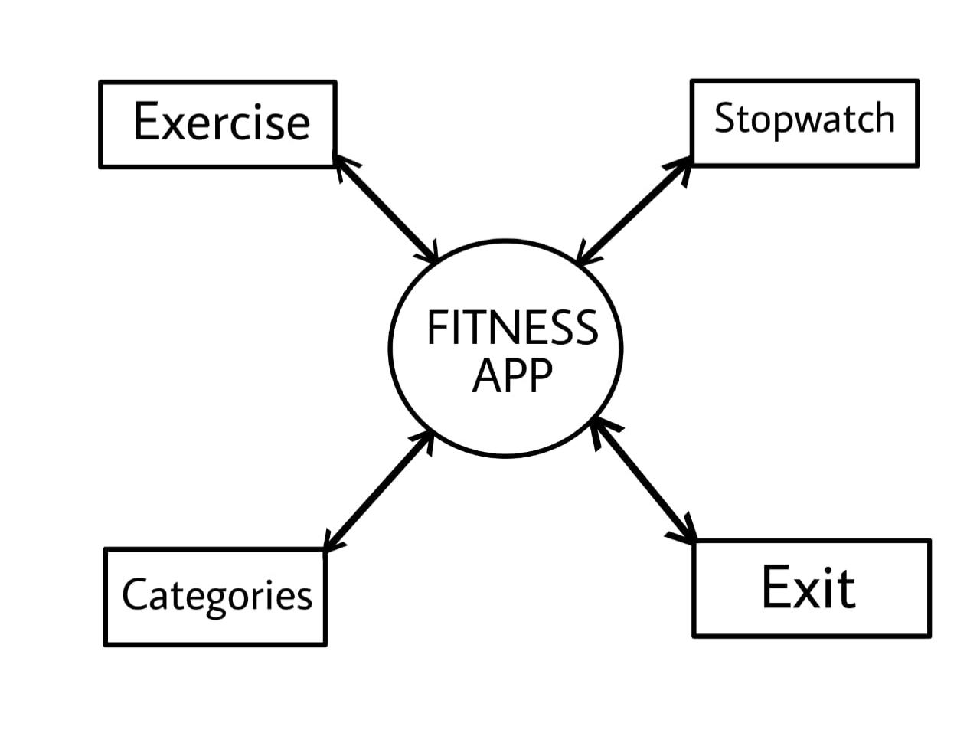
DFD LEVEL 1

Slide 16
CONCLUSION
The project titled Android Fitness App is an android based application that enables the user to keep an eye on their fitness regime. The project has been completed successfully with maximum satisfaction.
I hope you have enjoyed learning about how to stay fit. There are many ways to exercise along with many healthy foods you can eat to help stay fit.
To create the level of enthusiasm among the users this app has a practical approach. Daily exercising would keep them healthy and fit.
Here is the application which helps the user in finding the right exercise for his/her age group and performing them for in a order of time.

Slide 17
THANK YOU…
☺

